Slide 1




AI-Powered Road Accident Detection from Pre-Recorded CCTV and Dashcam Videos
An intelligent computer vision system leveraging hybrid deep learning and motion analysis for automated accident detection in real-world surveillance footage
ACADEMIC RESEARCH
COMPUTER VISION

Slide 2
Project Overview
Developed By:
Research Focus
Mohit Kumar
This project addresses critical limitations in existing accident detection systems by combining multiple computer vision techniques into a unified, robust framework suitable for real-world deployment.
Roll No: 2024OAI1031
Executive M.Tech (AI & ML)
3rd Semester (Cohort 4)
IIT Jammu
YOLOv8 object detection for multi-class vehicle tracking
Dense optical flow analysis for motion anomaly detection
Entropy-based scene dynamics measurement
ResNet-18 deep CNN for semantic accident confirmation
Multi-event temporal segmentation for long videos
Under Guidance & Mentorship of Professor Dr. Harkeerat Kaur
Designed for practical deployment in traffic monitoring systems, emergency response networks, and intelligent transportation infrastructure.

Slide 3
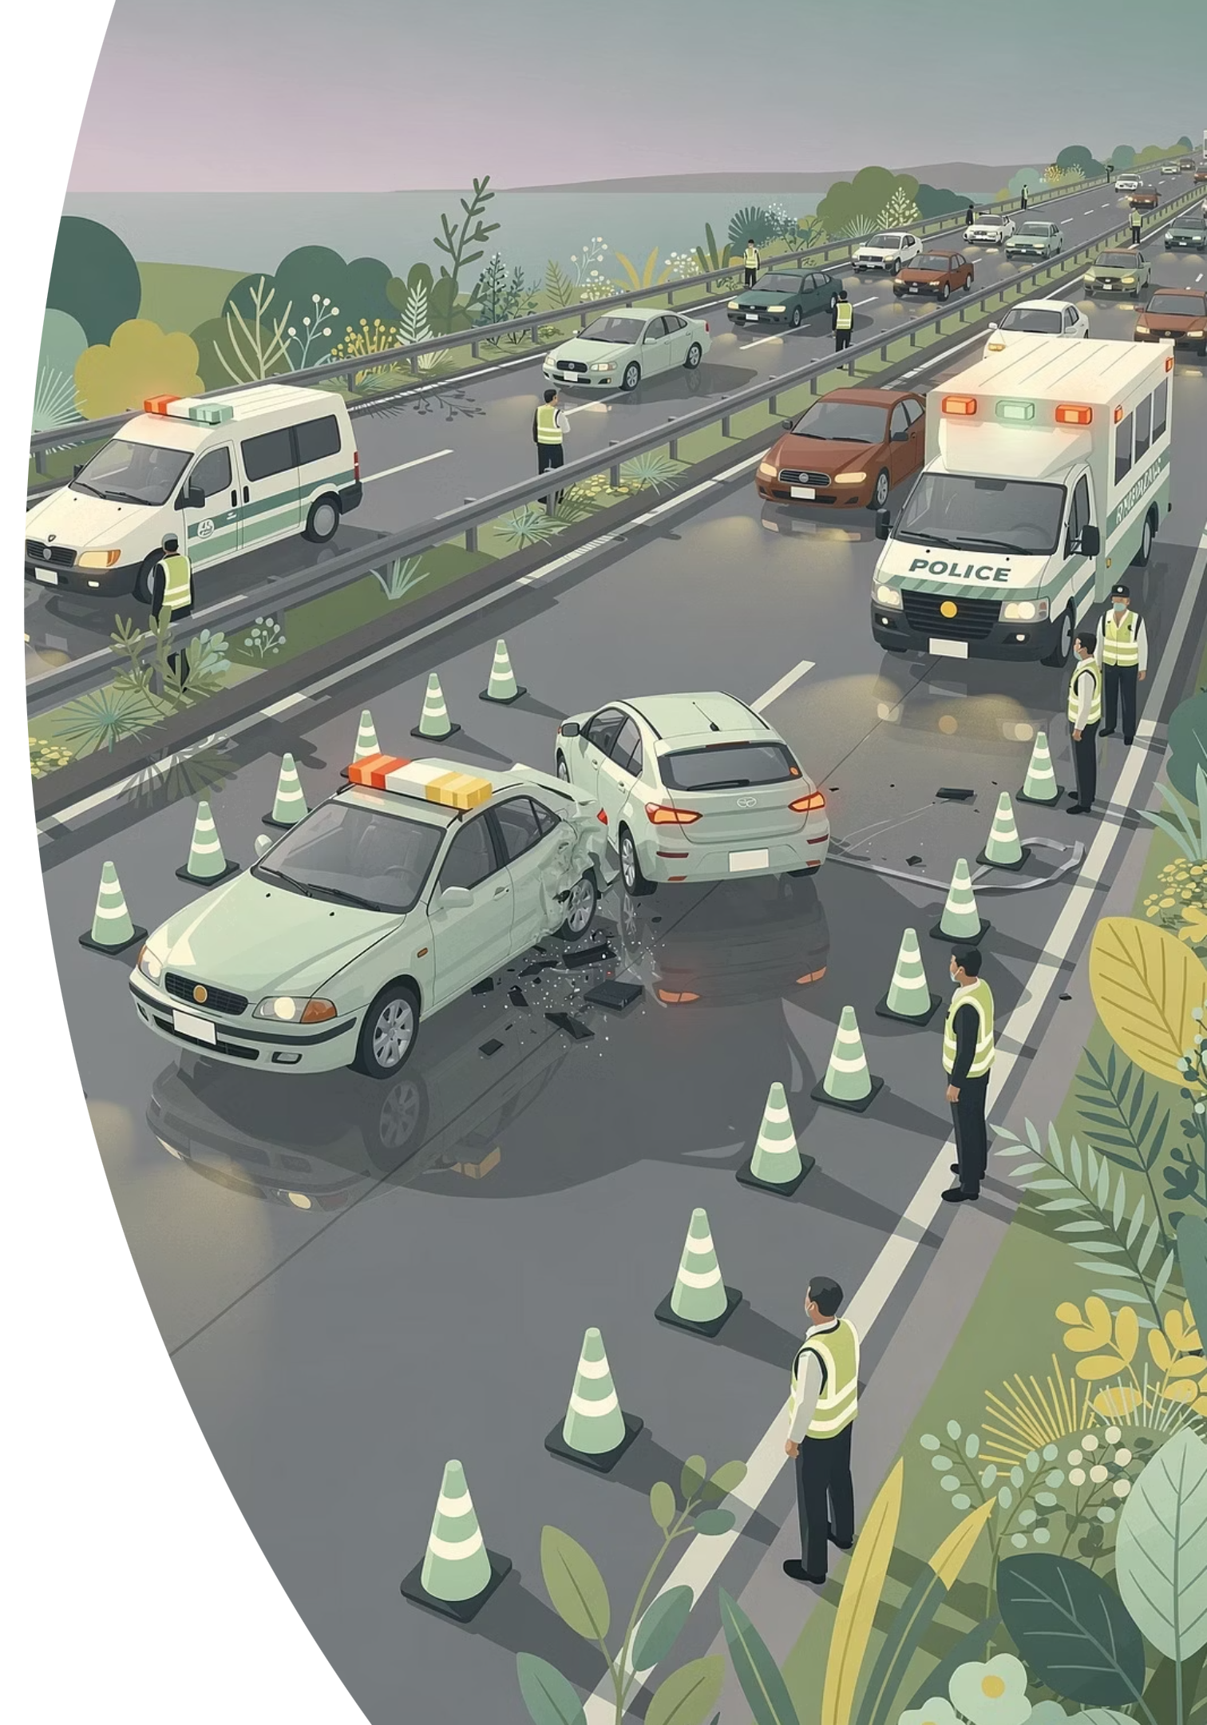
The Problem Domain
Road accidents remain a leading cause of fatalities and injuries worldwide. Traditional manual monitoring of CCTV footage is labor-intensive, prone to delays, and cannot scale to city-wide surveillance networks. Automated accident detection systems are essential for:
Rapid Emergency Response
Continuous Monitoring
Providing 24/7 surveillance across multiple camera feeds without human fatigue or attention lapses
Reducing response time from minutes to seconds by automatically alerting authorities when accidents occur
Data-Driven Analysis
Enabling systematic analysis of accident patterns, high-risk locations, and contributing factors for traffic safety improvements

Slide 4

Base Research Paper : YoFlow Method
Publication Details
YoFlow Approach Summary
Authors: Aditya Haryanto and Ondrej Vaculin
The YoFlow method represents a scenario-based accident detection system that combines YOLO object detection with optical flow-based analysis for traffic monitoring.
Published: June 27, 2025
Affiliation: Institute of Safety in Future Mobility (C-ISAFE), CARISSMA Automotive Safety Research Centre, Technische Hochschule Ingolstadt, 85055 Ingolstadt, Germany.
Publication: The work was submitted to the IEEE Open Journal of Intelligent Transportation Systems in May 2025 and appeared on TechRxiv in June 2025.
Relies primarily on object detection confidence scores
Designed for simulated traffic scenarios and controlled environments
Uses predefined traffic patterns and geometric constraints
Focuses on vehicle-to-vehicle collision detection
Assumes single-event accidents in fixed RSU camera views

Slide 5
Key Limitations of YoFlow Addressed
Synthetic Data Dependency
Predefined Scenario Constraints
Limited Event Detection
YoFlow relies on synthetic simulation data, limiting real-world applicability. Our system operates directly on real CCTV and dashcam footage, eliminating the simulation-to-reality gap.
The original method requires predefined traffic scenarios and manual feature engineering. We use deep semantic learning to enable better generalization across diverse conditions.
YoFlow assumes single-event accidents and struggles with multiple incidents in one video. Our temporal segmentation supports multi-event detection in long surveillance recordings.
Narrow Scope Coverage
Viewpoint Sensitivity
The base method focuses primarily on vehicle-to-vehicle collisions. We extend detection to pedestrians, bikes, trucks, and complex multi-actor interactions.
YoFlow is sensitive to fixed RSU camera constraints. Our approach handles uncontrolled camera conditions including moving dashcams, occlusion, and varying lighting.

Slide 6
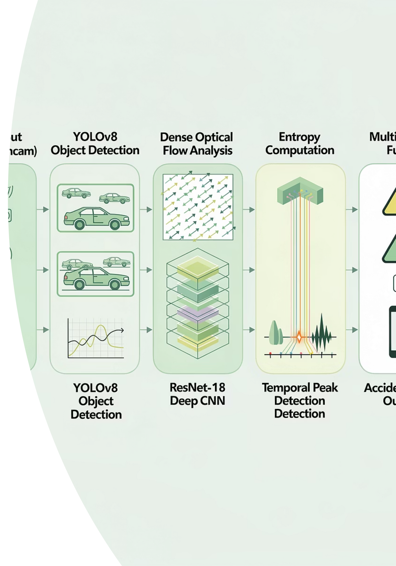





System Architecture Overview
Our hybrid approach integrates five complementary techniques to achieve robust accident detection across diverse real-world conditions.
Video Input
CCTV footage, dashcam recordings, or URLs
Multi-Signal Analysis
YOLOv8, optical flow, entropy computation
Deep Classification
ResNet-18 semantic confirmation
Temporal Detection
Multi-event segmentation and peak analysis
Accident Output
Event timestamps and severity indicators

Slide 7
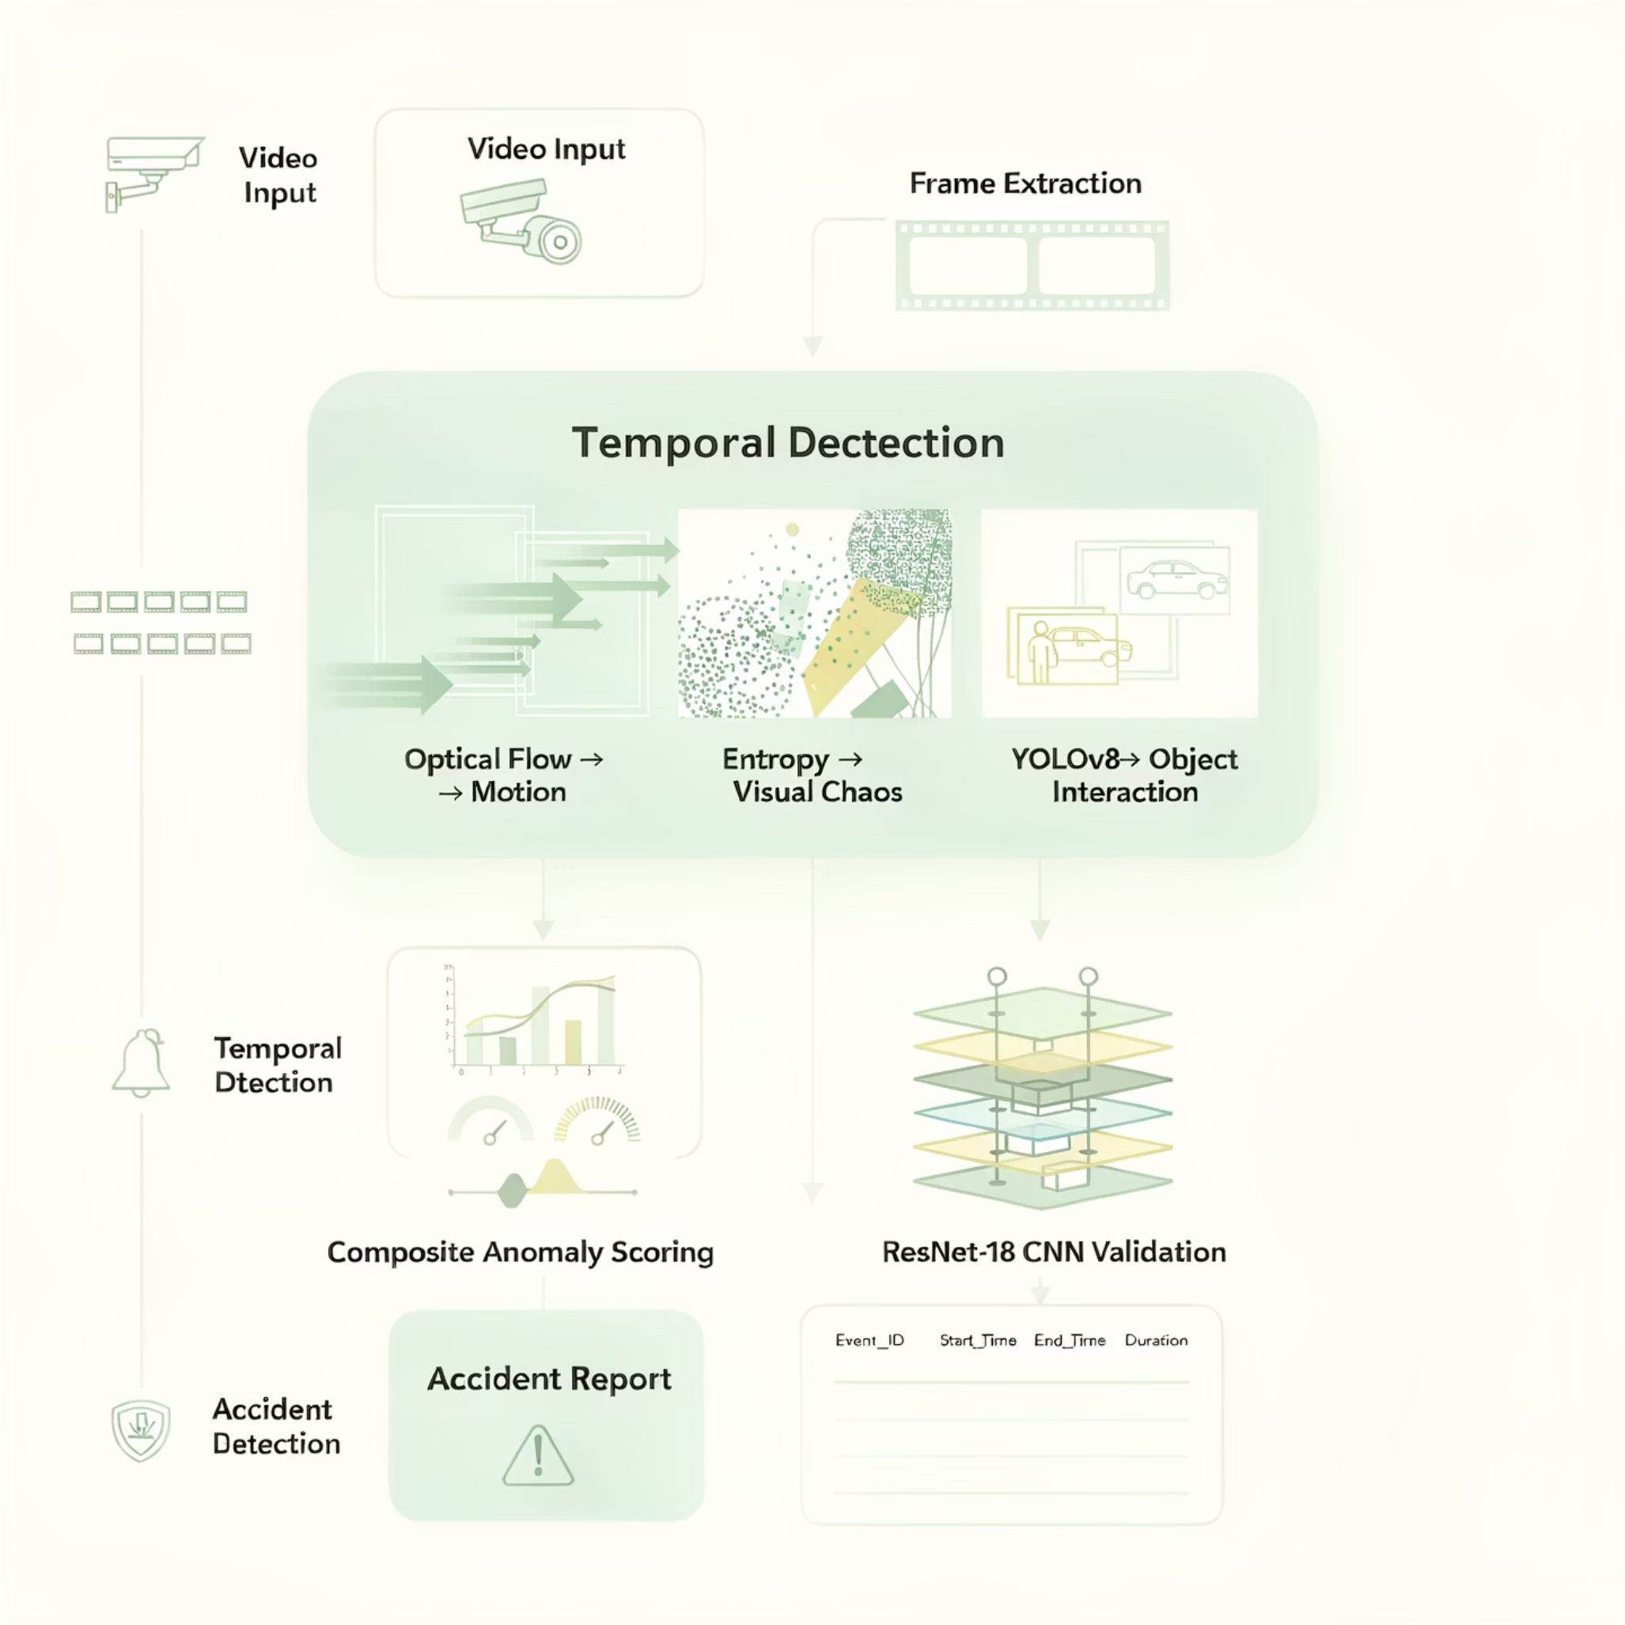
Detailed System Architecture Diagram
This diagram presents the complete system architecture, illustrating how all components interact and process data from various video inputs to detect and report road accidents effectively. It highlights the layered approach, from initial video intake through advanced deep learning and temporal analysis, culminating in real-time alert generation.

Slide 8
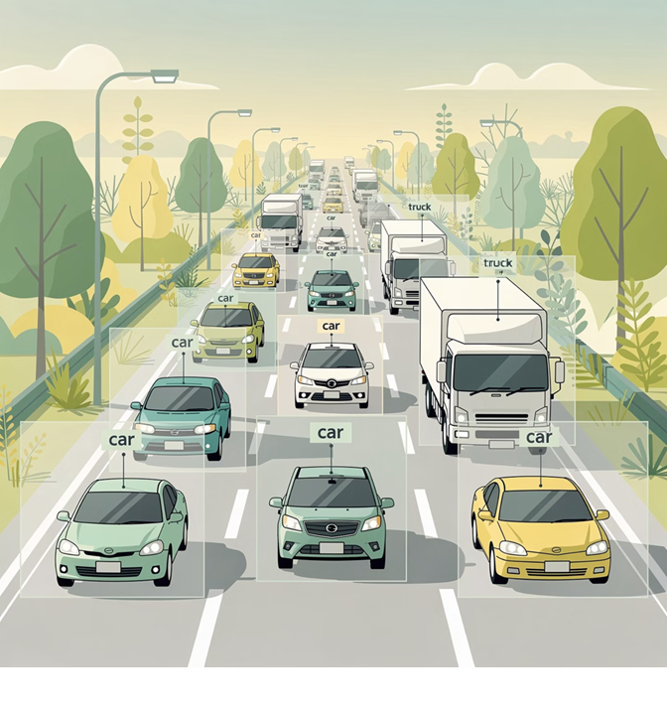
Component 1: YOLOv8 Object Detection
Multi-Class Vehicle Tracking
YOLOv8n provides real-time object detection across multiple vehicle and pedestrian classes, forming the foundation of our accident detection pipeline.
Detected Classes: Cars, trucks, motorcycles, bicycles, pedestrians, traffic signs
Batch Processing: Analyzes 4 frames simultaneously for computational efficiency
Object Count Signal: Number of detected objects contributes to composite anomaly score
Unlike YoFlow's reliance on detection confidence alone, we treat object count as one of multiple complementary signals rather than the primary accident indicator.

Slide 9
Component 2: Dense Optical Flow Analysis
Motion Magnitude as Anomaly Signal
Optical Flow Formula
We employ Farnebäck dense optical flow to compute pixel-level motion vectors between consecutive frames, capturing sudden changes in movement patterns characteristic of accidents.
Computing motion between frames:
Algorithm: cv2.calcOpticalFlowFarneback with optimized parameters
Output: Mean magnitude of motion vectors across entire frame
Anomaly Indication: Sudden spikes indicate abrupt deceleration, collision impact, or chaotic movement
Temporal Smoothing: Rolling window analysis prevents false positives from normal traffic variations
Where u and v are horizontal and vertical motion components extracted from dense flow field.

Slide 10

Component 3: Entropy-Based Scene Dynamics
Visual Chaos Measurement
Shannon Entropy Formula
Shannon entropy quantifies the randomness and disorder in frame intensity distributions, serving as a novel indicator of accident-related visual disruption.
Computation Process
Where p_i represents the normalized probability of intensity bin i, and \epsilon = 10^{-6} prevents numerical instability.
Convert frame to grayscale representation
Compute intensity histogram with 64 bins over range [0, 255]
Normalize histogram to probability distribution
Calculate Shannon entropy using formula below
Higher entropy indicates greater visual disorder and unpredictability in the scene.
Innovation: This entropy-based analysis is entirely absent from YoFlow and provides unique sensitivity to visual chaos during collisions, debris scatter, and post-accident scene disruption.

Slide 11
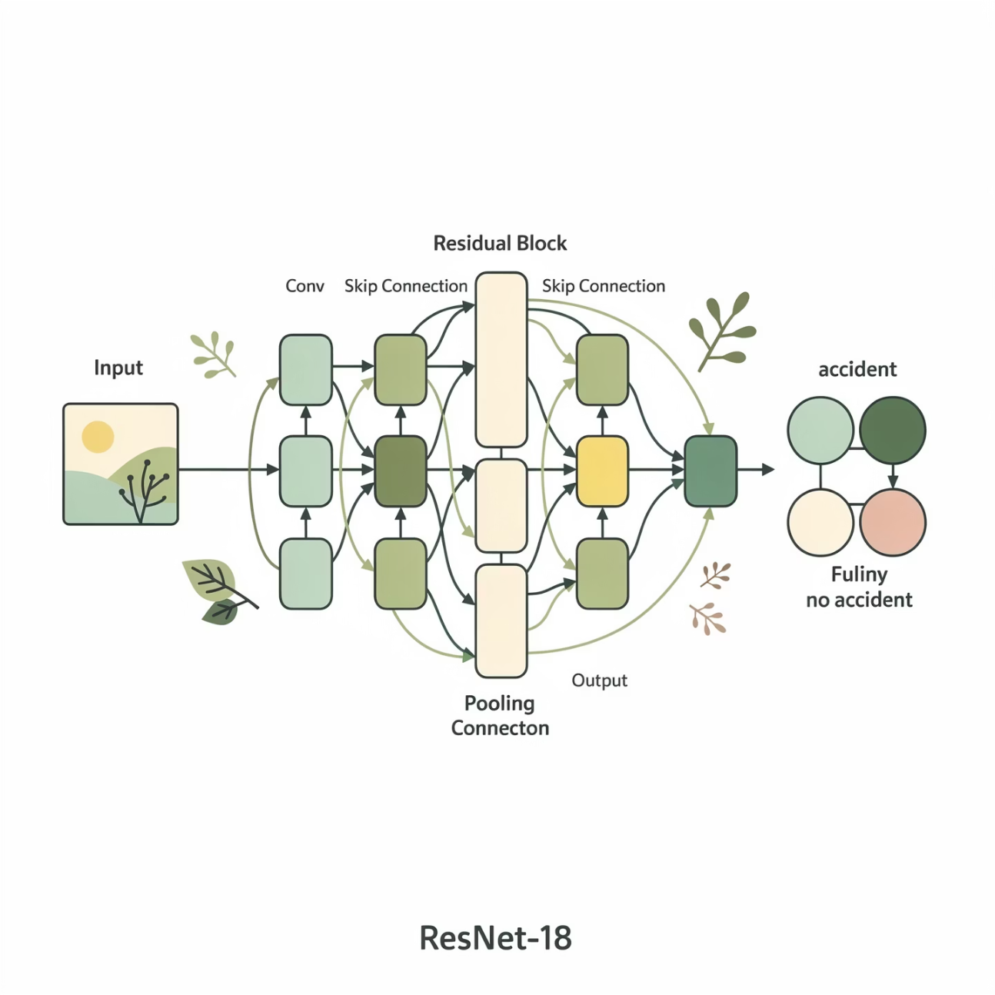
Component 4: ResNet-18 Semantic Classification
Deep CNN Accident Confirmation
A pretrained ResNet-18 architecture, fine-tuned on real accident footage, provides high-level semantic understanding to confirm accident frames flagged by motion and entropy signals.
Architecture: ResNet-18 with modified final layer for binary classification
Training Data: Kaggle "Accident Detection From CCTV Footage" dataset containing real accident and non-accident frames
Purpose: Reduces false positives by learning true visual semantics of accidents including vehicle deformation, debris, and scene aftermath
Inference: Applied to frames exceeding composite anomaly threshold for final validation
This semantic layer addresses YoFlow's lack of explicit accident understanding beyond geometric constraints.

Slide 12
Multi-Signal Fusion and Scoring
Composite Anomaly Score Formula
We combine optical flow, entropy, and object detection into a unified accident likelihood metric:
Score = 3.0 × Flow + 2.2 × Entropy + Object Count
Weight Rationale
Temporal Peak Detection
Flow (3.0): Primary indicator of sudden motion changes during collisions
Entropy (2.2): Strong secondary signal for visual disruption and chaos
ObjectCount (1.0): Contextual information about scene complexity
Composite scores undergo rolling window analysis to identify statistically significant peaks indicating accident events.
Adaptive threshold: \mu + 2.5\sigma per window
Multi-event segmentation with 4-second merge gap
Pre-event (1.2s) and post-event (2.5s) buffers for context
These empirically determined weights balance sensitivity and specificity across diverse accident types and camera viewpoints.

Slide 13
Real-World Training Dataset
Kaggle Accident Detection Dataset
Data Composition
Our system is trained and validated on the "Accident Detection From CCTV Footage" dataset, containing authentic surveillance recordings of traffic accidents and normal driving conditions.
Accident Frames: Collisions, near-misses, post-crash scenes
Non-Accident Frames: Normal traffic flow, congestion, lane changes
Dataset Source: https://www.kaggle.com/datasets/ckay16/accident-detection-from-cctv-footage
Validation: YouTube dashcam videos and additional CCTV footage for generalization testing
Dataset Advantages
Realism: Real CCTV footage eliminates simulation-to-reality gap present in synthetic approaches
Diversity: Multiple camera angles, weather conditions, lighting scenarios, and accident types
Semantic Learning: Model learns true visual patterns of vehicle deformation, debris, and collision aftermath
Noise Robustness: Training on real-world video includes compression artifacts, motion blur, and occlusion

Slide 14
System Output and Performance
Multi-Event Detection Results
The system generates structured output identifying all accident events in a video with precise temporal boundaries:
Enter video URL: https://www.youtube.com/shorts/SlP5KfKzTpw Analyzing frame 475/476 Analysis completed. ===== ACCIDENT ANALYSIS RESULT ===== Event_ID Start_Time End_Time Start_Frame End_Frame 1 00:12 00:12 350 356
Global Constants:
GLOBAL_STD_FACTOR controls how abnormal a frame must be to count as an accident
FRAME_STRIDE controls how often frames are analyzed to balance speed vs accuracy
MERGE_GAP_SECONDS controls how nearby detections are merged into a single accident for displaying unique accidents occurrence
Key Capabilities
Processing Efficiency
Detects multiple accidents within single long video
Provides frame-accurate temporal localization
Includes pre- and post-event context windows
Outputs structured CSV for integration with traffic management systems
Handles variable video lengths and frame rates automatically
3
4
Frame Stride
Batch Size
Analyzes every 3rd frame for real-time feasibility
Processes 4 frames simultaneously in YOLO

Slide 15
Limitations of Current Implementation:
Sensitivity Bias Toward High-Energy Accidents
1
The current anomaly detection logic relies on statistical thresholds and motion intensity, which makes the system more effective at detecting severe accidents while minor or low-speed collisions may go unnoticed.
Heuristic-Based Decision Logic
2
Accident likelihood is computed using manually weighted features (optical flow, entropy, object count). These weights are not learned end-to-end and may not generalize optimally across all traffic environments.
Limited Temporal Understanding
3
The system analyzes short-term frame-to-frame changes and does not model long-range temporal dependencies, which can be important for slow-developing or subtle accident scenarios.
4
Dependence on Visual Quality
Performance degrades under poor lighting, rain, fog, night-time conditions, or camera shake, as both optical flow and entropy are sensitive to visual noise.
No Contextual Traffic Semantics
5
The system does not incorporate traffic rules, lane structure, speed limits, or road geometry, which limits its ability to distinguish accidents from aggressive but legal driving behavior.
6
Pre-Recorded Video Assumption
The current implementation is designed for offline analysis and is not optimized for strict real-time latency constraints in live surveillance systems.

Slide 16
Future Scope and Enhancements
1
Real-Time Stream Processing
2
Accident Severity Classification
Extend from offline video analysis to real-time CCTV stream processing with GPU optimization, enabling instant accident alerts to traffic authorities and emergency services within seconds of occurrence.
Enhance system to categorize accidents into minor, major, and critical severity levels using motion intensity, object interaction patterns, vehicle deformation analysis, and post-impact scene dynamics.
3
Automatic Clip Extraction
4
Explainable AI Integration
Implement automatic extraction and storage of short video clips surrounding detected accidents, including pre-event context, for rapid review by operators, law enforcement, and insurance investigations.
Add visual explanations including motion heatmaps, optical flow overlays, attention region highlighting, and entropy visualizations to improve transparency, trust, and interpretability of detection decisions.
5
Trajectory Prediction
6
ITS Integration
Incorporate advanced object interaction modeling with trajectory prediction and interaction graphs to better understand complex vehicle-pedestrian-bike interactions before and after accidents, enabling proactive hazard detection.
Connect accident detection outputs with Intelligent Transportation Systems including adaptive traffic signal control, automated emergency vehicle routing, real-time navigation updates, and proactive congestion management.

